Slide 1
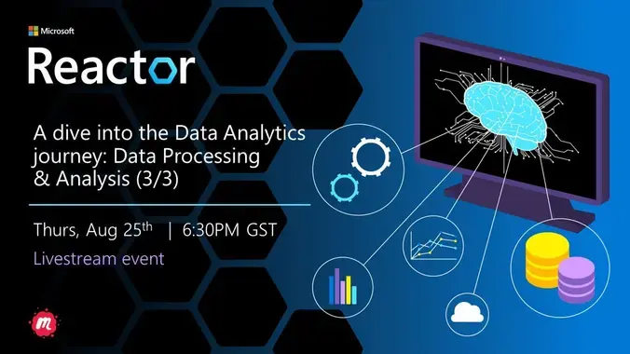

Slide 2

Our Code of Conduct
Be welcoming and respectful
Be open to all questions and viewpoints
Be understanding of differences
Be kind and considerate to others
Be aware of others
Be friendly and patient
Microsoft is dedicated to empowering every person and every organization on the planet to achieve more. This includes Microsoft Reactor events where we seek to provide a respectful, friendly, professional experience for everyone, regardless of gender, sexual orientation, physical appearance, disability, age, race or religion. We do not tolerate any behaviour that is harassing or degrading to any individual, in any form. Individuals are responsible for knowing and abiding by these standards. We encourage everyone to assist in creating a welcoming and safe environment.
Notes:
Before we get into it a quick word on our code of conduct.
The key thing to take out here is to be respectful of other people’s views, understanding of differences and kind and considerate in the way you engage.
The chat will be open throughout and we do encourage you all to participate.
And with that, I will hand over to Ben.

Slide 3



Speaker Bio
Hadeel Shubair
Regional Cloud Advocate - Microsoft
Hadeel Shubair
@Hshubair3

Slide 4
Learning Objectives
Data Science Lifecycle – Overview
Data Processing & Analysis
Machine Learning Algorithms
Example - walkthrough

Slide 5

Data science is an iterative process between:
The knowledge and understanding of what is today
Data that has been collected
Questions that are being asked

Slide 6
Data Science lifecycle

Slide 7
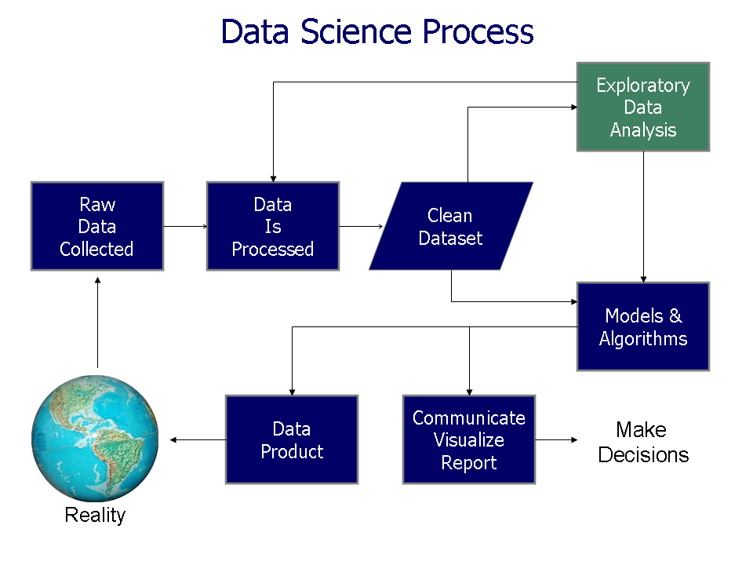

Slide 8
We already explored the first two stages: - Data cleaning & preprocessing - Data exploration & visualization

Slide 9
1. Data Preprocessing & Cleaning
Data should be preprocessed and cleaned to get rid of noisy data.
We collected our data, inspected it, then had to clean it. The steps taken to clean our data include:
Dealing with missing data
Removing unused columns
Converting categorical into categorical numerical data
Normalization: standardize data ranges for all features (between 0 & 1) – Min-max normalization

Slide 10
2. Data Exploration & Visualization
Exploratory data analysis is an approach of analyzing data sets to summarize their main characteristics, often using statistical graphics and other data visualization methods
Used to discover trends, patterns, or to check assumptions with the help of statistical summary and graphical representations.
A good starting point for defining future studies and getting to know your data to get deeper insights.
Data Visualization is the process of analyzing data in the form of graphs or maps, making it a lot easier to understand the trends or patterns in the data.
Raw data → Visual figures

Slide 11
Today, we will focus on the last stage: Data Processing/Analysis

Slide 12
Intro
Much of data management is essentially about extracting useful information from data
To do this, data must go through a data mining process to be able to get meaning out of it
There are a wide range of approaches/techniques to do this. Its important to start with the most basic understanding of processing data

Slide 13

What is Data Processing?

Slide 14
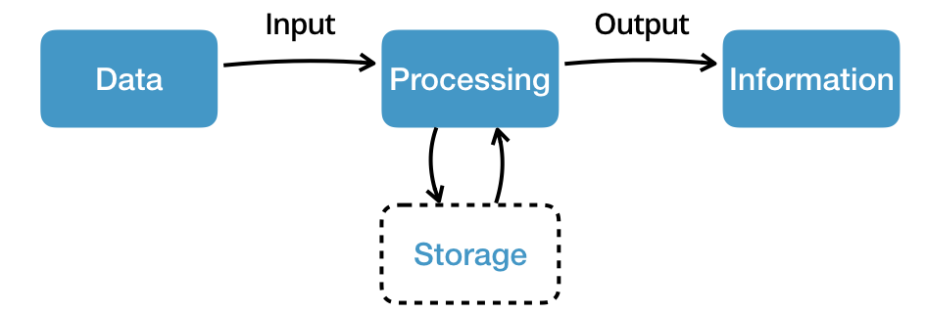
Data Processing
Data processing: the conversion of raw data to meaningful information through a process
Data is technically manipulated to produce results that lead to a resolution of a problem or improvement of an existing situation
Similar to a production process, it follows a cycle where inputs (raw data) are fed to a process (computer systems, software, etc.) to produce output (information and insights).

Slide 15
Why is Data Processing important?

Slide 16
Data Processing - Importance
Through data processing, companies can:
Gain valuable insights
Make informed business decisions
Create better business strategies
Secure a competitive edge by narrowing down data to obtain the most accurate, dependable information
When you know the importance of data processing in quantitative research and can successfully implement these methods, you can develop better outcomes for your business!

Slide 17


Data Processing: Real-life examples
Data processing occurs in our daily lives whether we may be aware of it or not. Some real-life examples include:
An e-commerce company uses the search history of customers to recommend similar products
A digital marketing company uses demographic data of people to strategize location-specific campaigns
A self-driving car uses real-time data from sensors to detect if there are pedestrians/other cars on the road

Slide 18

Data Analysis

Slide 19
Intro
The world is becoming more and more data-driven, with endless amounts of data available to work with
Data analysis plays a crucial role in processing big data into useful information
Data analysis is the process of evaluating data using analytical or statistical tools to discover useful information
Once data is collected and sorted using tools, the results are interpreted to make decisions. The end results can be delivered as a summary, or as a visual - chart or graph.

Slide 20
Although many groups, organizations, and experts have different ways to approach data analysis, most of them can be distilled into a one-size-fits-all definition.
Data analysis is the process of cleaning, changing, processing raw data, and extracting actionable, relevant information that helps businesses make informed decisions.
The procedure helps reduce the risks inherent in decision-making by providing useful insights and statistics, often presented in charts, images, tables, and graphs.

Slide 21

Data Processing
Uses Data analytics techniques & methods for analysis, depending on the problem.
Model Selection
Model Training
Model Evaluation

Slide 22
Why is Data Analysis important?

Slide 23
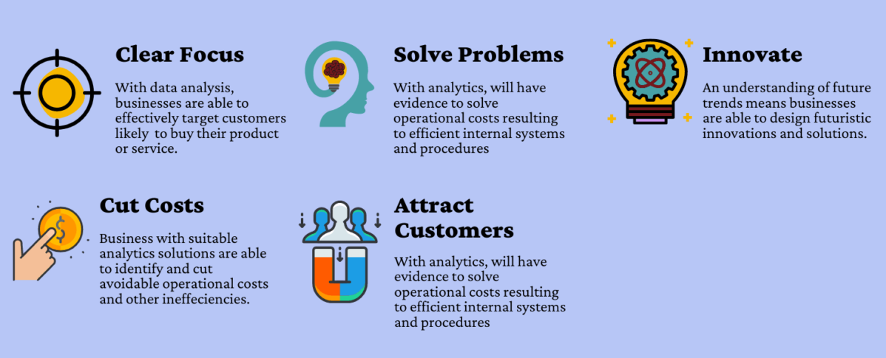
The importance of Data Analytics

Slide 24
Types of Data Analysis

Slide 25
There are four types of data analysis that are in use across all industries.
While we separate these into categories, they are all linked together and build upon each other.
As you begin moving from the simplest type of analytics to more complex, the degree of difficulty and resources required increases. At the same time, the level of added insight and value also increases.

Slide 26
Types of Data Analysis
Descriptive Analysis
Diagnostic Analysis
Predictive Analysis
Prescriptive Analysis
Understanding the what, why, when, where, and how of your data analytics helps to drive better decision making and enables your organization to meet its business objectives
- We will introduce each type and give examples of how they are utilized in business.

Slide 27
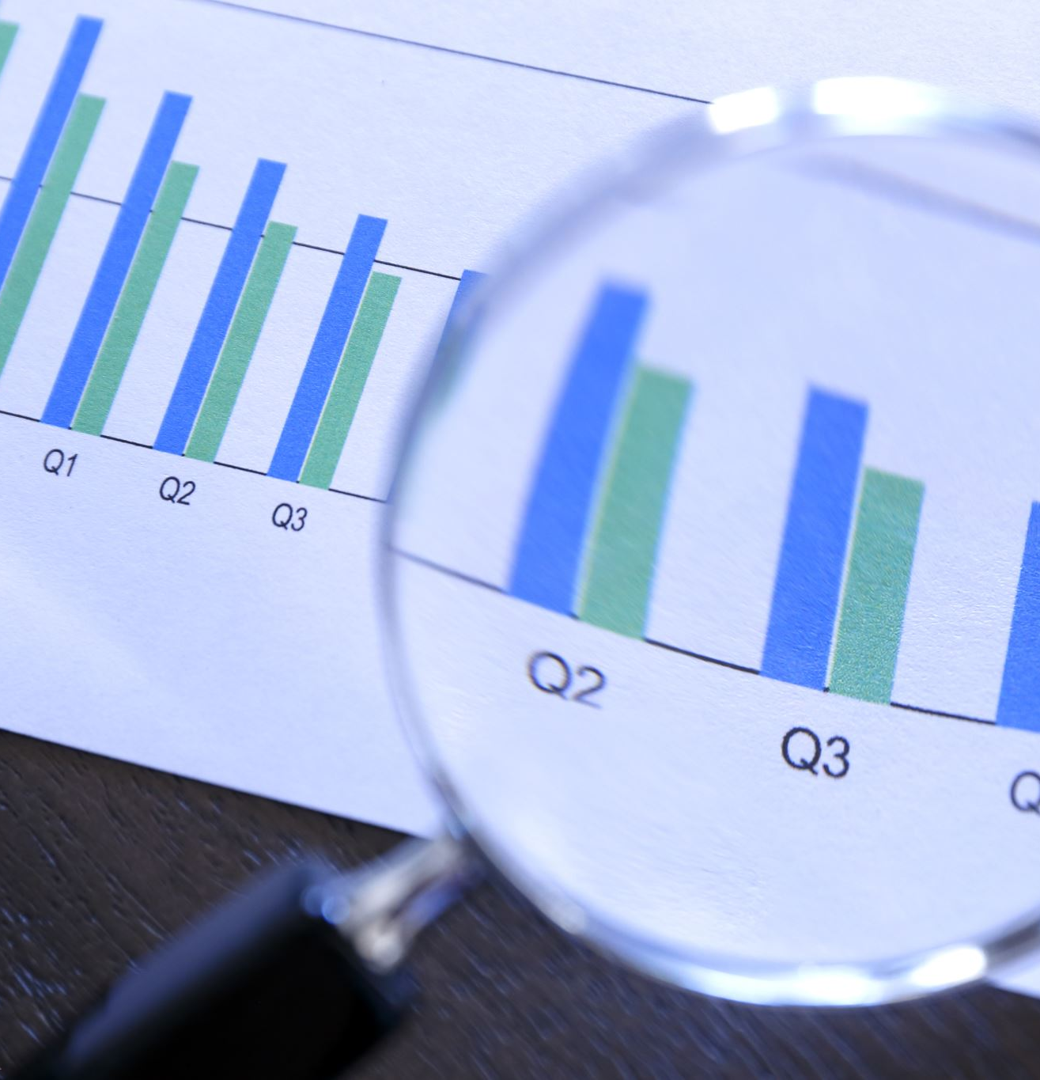
Descriptive Analysis
Descriptive Analysis is at the foundation of all data insight. It is the simplest and most common use of data in business today.
Answers the “what happened” by summarizing past data, usually in the form of dashboards.
The biggest use of descriptive analysis in business is to track Key Performance Indicators (KPIs). KPIs describe how a business is performing based on chosen benchmarks.
Business applications of descriptive analysis include:
KPI dashboards – revenue per customer, average time customers take to pay bills
Monthly revenue reports
Sales leads overview – how many sales occurred in the last quarter? Did they increase or decrease?

Slide 28

Diagnostic Analysis
After asking the main question of “what happened”, the next step is to dive deeper and ask why did it happen? This is where diagnostic analysis comes in.
Diagnostic analysis takes the insights found from descriptive analytics and drills down to find the causes of those outcomes.
Business applications of diagnostic analysis include:
A freight company investigating the cause of slow shipments in a certain region
A SaaS company drilling down to determine which marketing activities increased trials

Slide 29

Predictive Analysis
Predictive analysis attempts to answer the question “what is likely to happen”. This type of analytics utilizes previous data to make predictions about future outcomes.
Predictive analysis uses the data we have summarized to make logical predictions of the outcomes of events.
This analysis relies on statistical modeling, which requires added technology and manpower to forecast. It is also important to understand that forecasting is only an estimate; the accuracy of predictions relies on quality and detailed data.
Business applications of predictive analysis include:
Sales Forecasting
Using customer segmentation to determine which leads have the best chance of converting
Predictive analytics in customer success teams

Slide 30
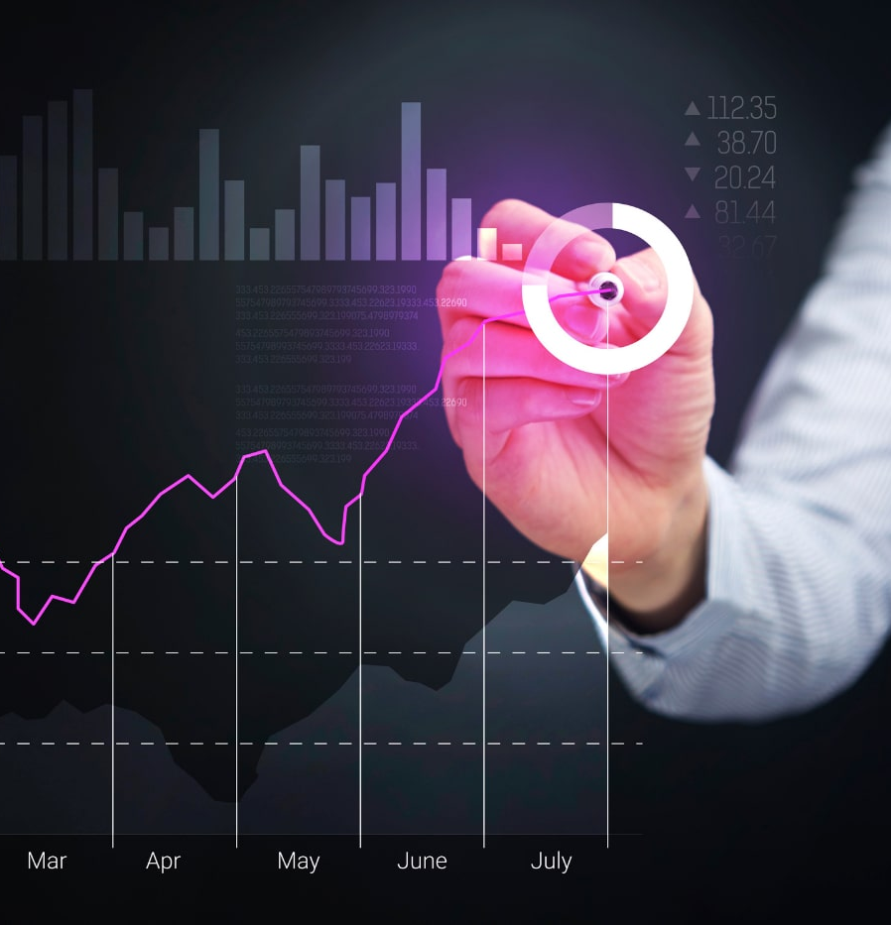
Prescriptive Analysis
Prescriptive analysis is the frontier of data analysis, combining the insight from all previous analyses to determine the course of action to take in a current problem or decision.
Prescriptive analysis utilizes state of the art technology and data practices.
AI is a perfect example of prescriptive analytics. AI systems consume a large amount of data to continuously learn and use this information to make informed decisions.
Currently, most of the big data-driven companies (Apple, Facebook, Netflix, etc.) are utilizing prescriptive analytics and AI to improve decision making.

Slide 31
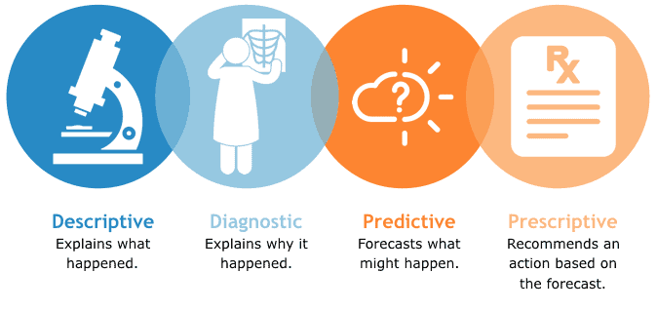

Slide 32

Conclusion
As we have shown, each of these types of data analysis are connected and rely on each other to a certain degree.
They each serve a different purpose and provide varying insights. Moving from descriptive analysis towards predictive and prescriptive analysis requires much more technical ability, but also unlocks more insight for your organization.

Slide 33
Data Processing - Steps

Slide 34
Select, build, and test models
Data processing is all about model selection, building, and testing. In this step, the analytical approach is put together and tested.
A few considerations will help select one or more appropriate statistical or machine learning models:
What are the data types? Categorical, ordered, continuous, or mixed.
Is there a time index to consider?
Are there rules and constraints that need to be incorporated into the model?
What models have others used for similar problems?
With a few candidate models selected, the next step is model building, testing, and tuning. In this step the models are configured, validated, and fine-tuned to get better accuracy.
- Test & check which model gives the best results (highest accuracy/lowest error)

Slide 35
Model deployment
After selecting, building, and tuning models, the next step is model deployment. The goal of model deployment is to produce outputs that lead to a decision or action.
Some examples of what decisions might look like after evaluating and translating model outputs:
Raise price
Launch the promotion
Change the policy
Change the mixture
In a data science application, model deployment is often automated while still allowing analyst users to override and influence the model’s recommendations.

Slide 36
Monitor and validate
The final step in a data analysis process is monitoring and validation.
After decisions have been put into play and allowed a short time to work, it's important to go back and check to see if outcomes are as expected.
Monitoring and validating results can take many forms.
For example, summary reports and simple charts of actual versus targets or average revenue or sales over time.

Slide 37
Types of Algorithms

Slide 38
Intro
The implementation of Data Science to any problem requires a set of skills. Machine Learning is an integral part of this skill set.
For doing Data Science, you must know the various Machine Learning algorithms used for solving different types of problems, as a single algorithm cannot be the best for all types of use cases.
These algorithms find an application in various tasks like prediction, classification, clustering, etc. from the dataset under consideration.

Slide 39
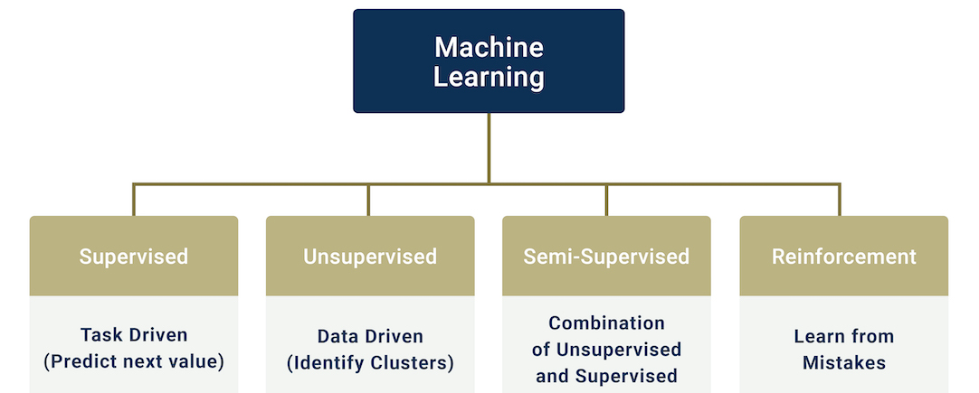
ML Algorithms:
Machine learning algorithms are broadly classified into three categories:
Supervised Learning – Labeled data. Used to classify something or predict a value. [Example: Detecting fraudulent transactions from a list of credit card transactions]
Unsupervised Learning – Unlabeled data. Used to find patterns in given data. In this case, you are asking the machine learning model to process the data from which you can then draw conclusions. [Example: Customer segmentation based on spend data.]
Reinforcement Learning - Learning by trial and error. This is the closest to how humans learn. [Example: Personalized recommendations on streaming platforms like YouTube]

Slide 40

Splitting data: training & testing
The train-test split procedure is used to estimate the performance of ML algorithms when they are used to make predictions on data not used to train the model.
We need some data to train our model on & some data to test our model on to validate the model
Data scientists have noticed that 80:20, 70:30 are the most widely used ratios and give the best results
Empirical studies show that the best results are obtained if we use 20-30% of the data for testing, and the remaining 70-80% of the data for training.

Slide 41
Supervised Learning
In Supervised learning, we divide the data we have between training and testing.
We feed the training data to the algorithm [it learns from it & produces a model]
We feed the testing data to the model [to get an idea about the performance]
As supervised learning is used to classify something or predict a value, there are two types of algorithms for Supervised learning:
Classification models
Regression models

Slide 42
Types of Supervised learning
Classification: used to categorize data into a class or category. Classification refers to a predictive modeling problem where a class label is predicted for a given example of input data.
Example: Predicting if a transaction is fraud or not, classify if an email is spam or not
Classification Algorithms can be used to solve classification problems: Identification of spam emails, Speech Recognition, Identification of cancer cells, etc.
Regression: used to predict a numerical value.
Example: House price prediction, predicting the sale price of a house.

Slide 43
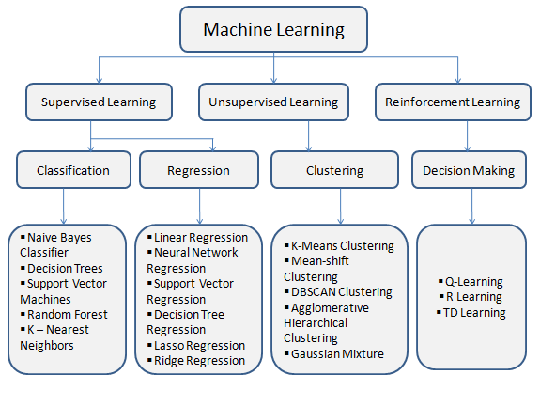

Slide 44
Most popular Algorithms (Supervised learning)
Classification: predicting a discrete class label
Regression: predicting a continuous quantity
Classification: | Regression:
Logistic Regression | Linear Regression
Naïve Bayes | Random Forest
Decision trees | Multilinear Regression

Slide 45
Classification Algorithms

Slide 46
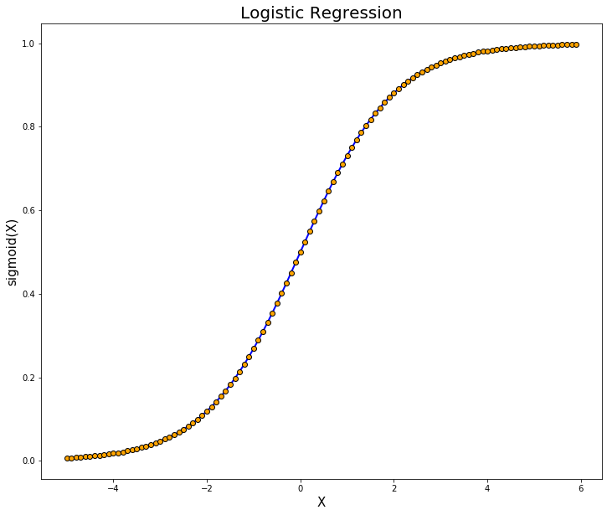
Logistic Regression
Logistic regression finds the most common application in solving binary classification problems, that is, when there are only two possibilities of an event, either the event will occur, or it will not occur (0 or 1).
It is a calculation used to predict a binary outcome: either something happens or does not based on prior observations of a dataset. This can be exhibited as Yes/No, Pass/Fail, etc.
Example: Applying machine learning to determine if a person is likely to be infected with COVID-19 or not
Applications:
In the financial industry, logistic regression can be used to predict if a transaction is fraudulent or not.
In marketing, logistic regression can be used to predict if a targeted audience will respond or not.

Slide 47
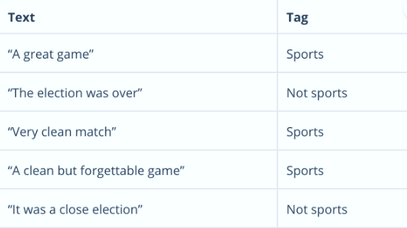
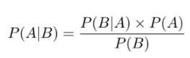
Naïve Bayes
Calculates the possibility of whether a data point belongs within a certain category or does not.
We use Naïve Bayes when we want to calculate the probability of the occurrence of an event in the future. In text analysis, it can be used to categorize words or phrases as belonging to a preset “tag” (classification) or not. For example:
To decide whether or not a phrase should be tagged as “sports,” you need to calculate:
Or… the probability of A, if B is true, is equal to the probability of B, if A is true, times the probability of A being true, divided by the probability of B being true.

Slide 48
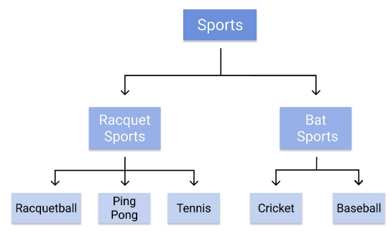
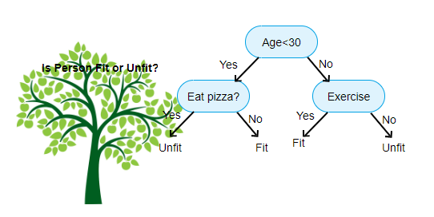
Decision trees
A SL algorithm that is perfect for classification problems, as it’s able to order classes on a precise level.
Works like a flow chart, separating data points into two similar categories at a time from the “tree trunk” to “branches,” to “leaves,” where the categories become more finitely similar - this creates categories within categories, allowing for organic classification with limited human supervision.
To continue with the sports example, this is how the decision tree works:
For example, if we are classifying a person as fit or unfit then the decision tree could look like this

Slide 49
Regression Algorithms

Slide 50

In Machine Learning, we use various kinds of algorithms to allow machines to learn the relationships within the data provided and make predictions based on patterns/rules identified from the dataset. Regression is a machine learning technique where the model predicts the output as a continuous numerical value. Regression analysis is often used in finance, investing, and others, and finds out the relationship between a single dependent variable(target variable) dependent on several independent ones. For example, predicting house price, stock market or salary of an employee are the most common regression problems.

Slide 51
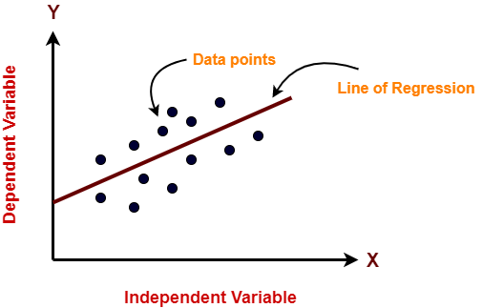
Linear Regression
Used for predicting the value of the dependent variable by using the values of the independent variable.
The linear regression model is suitable for predicting the value of a continuous quantity
The linear regression model represents the relationship between the input variables (x) & output variable (y) of a dataset in terms of a line given by the equation y = b0 + b1x
In linear regression, the outcome is continuous and can be any possible value
In this figure, X-axis is the independent variable and Y-axis is the output. The regression line is the best fit line for a model.
Our main objective in this algorithm is to find this best fit line.

Slide 52
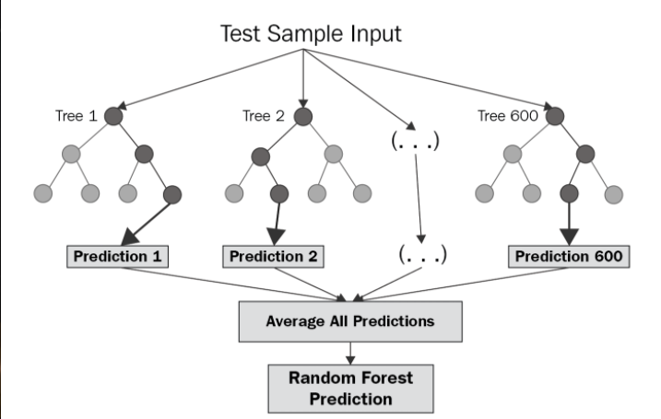
Random forest
Unlike decision tree regression (single tree), a random forest uses multiple decision trees for predicting the output.
Random data points are selected from the given dataset (say k data points are selected), and a decision tree is built with them via this algorithm. Several decision trees are then modeled that predict the value of any new data point.
Since there are multiple decision trees, multiple output values will be predicted via a random forest algorithm. You have to find the average of all the predicted values for a new data point to compute the final output.
Random forest can be used on both regression tasks (predict continuous outputs, such as price) or classification tasks (predict categorical or discrete outputs)

Slide 53
Multilinear Regression
A statistical technique that uses several explanatory variables to predict the outcome of a response variable.
Multiple regression is a type of regression where the dependent variable shows a linear relationship with two or more independent variables. It can also be non-linear, where the dependent and independent variables do not follow a straight line.
The formula for a multiple linear regression is:
y = the predicted value of the dependent variable
B_0 = the y-intercept (value of y when all other parameters are set to 0)
B_1X_1 = the regression coefficient (B_1) of the first independent variable (X_1) (a.k.a. the effect that increasing the value of the independent variable has on the predicted y value)
… = do the same for however many independent variables you are testing
B_nX_n = the regression coefficient of the last independent variable
Epsilon = model error (a.k.a. how much variation there is in our estimate of y)

Slide 54
Multilinear Regression
Used to estimate the relationship between two or more independent variables & one dependent variable.
You can use multiple linear regression when you want to know:
How strong the relationship is between two or more independent variables and one dependent variable (e.g. how rainfall, temperature, & amount of fertilizer added affect crop growth).
The value of the dependent variable at a certain value of the independent variables (e.g. the expected yield of a crop at certain levels of rainfall, temperature, & fertilizer addition).
Example:
You are a public health researcher interested in social factors that influence heart disease. You survey 500 towns and gather data on the percentage of people in each town who smoke, the percentage of people in each town who bike to work, and the percentage of people in each town who have heart disease.
Because you have two independent variables & one dependent variable, and all your variables are quantitative, you can use multlinear regression to analyze the relationship between them.

Slide 55
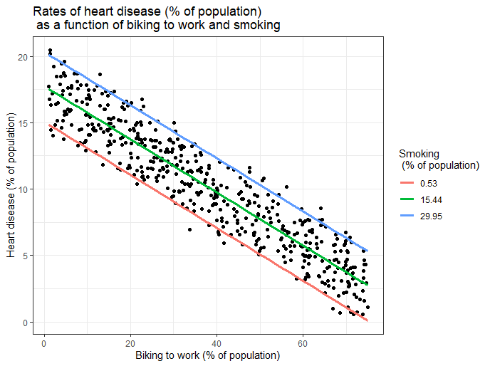
Multilinear Regression
In this figure, we calculated the predicted values of the dependent variable (heart disease) across the full range of observed values for the percentage of people biking to work.
To include the effect of smoking on the independent variable, we calculated these predicted values while holding smoking constant at the minimum, mean, and maximum observed rates of smoking.

Slide 56
Example: Medical Insurance cost prediction

Slide 57
Further learning/resources
Available on Microsoft Learn (for free!)
https://aka.ms/DataAnalyticsConcepts
https://aka.ms/DataAnalyticsConcepts2

Slide 58
Upcoming events

Slide 59


Slide 60


Slide 61


Thank You!
meetup.com/pro/microsoft-reactor/
@MSFTReactor
https://aka.ms/ReactorYouTube
aka.ms/ReactorEmailSignUp
https://www.meetup.com/pro/microsoft-reactor/

